Slide 1

Business Plan Presentation
Presented by:
Tang Wen Shuen
Chan Siang Sheng
Suen Kee Xian
Notes:
kx

Slide 2



Our Company
Background
Founded at January 2021
Based in Suntech@Penang Cybercity
Develops and provides AI-assisted smart education system
Notes:
kx

Slide 3


Our Company
Vision & Mission
Vision
Be the best AI-assisted smart education system provider in the industry, by equipping with the latest AI technologies.
Mission
To make the AI-assisted smart education system accessible by any educational institution that wishes to bring changes to the existing mode of Teaching and Learning.
Notes:
kx

Slide 4

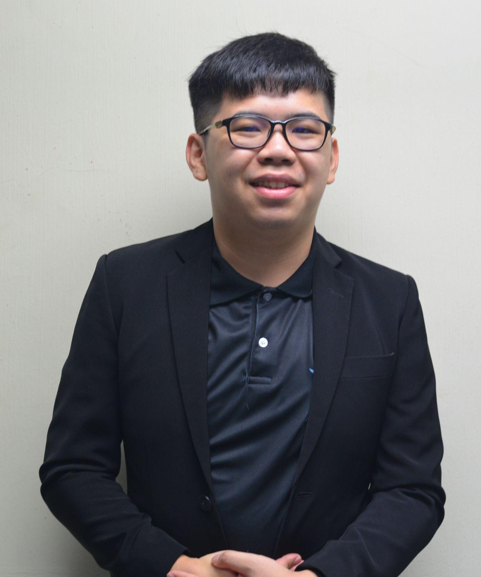
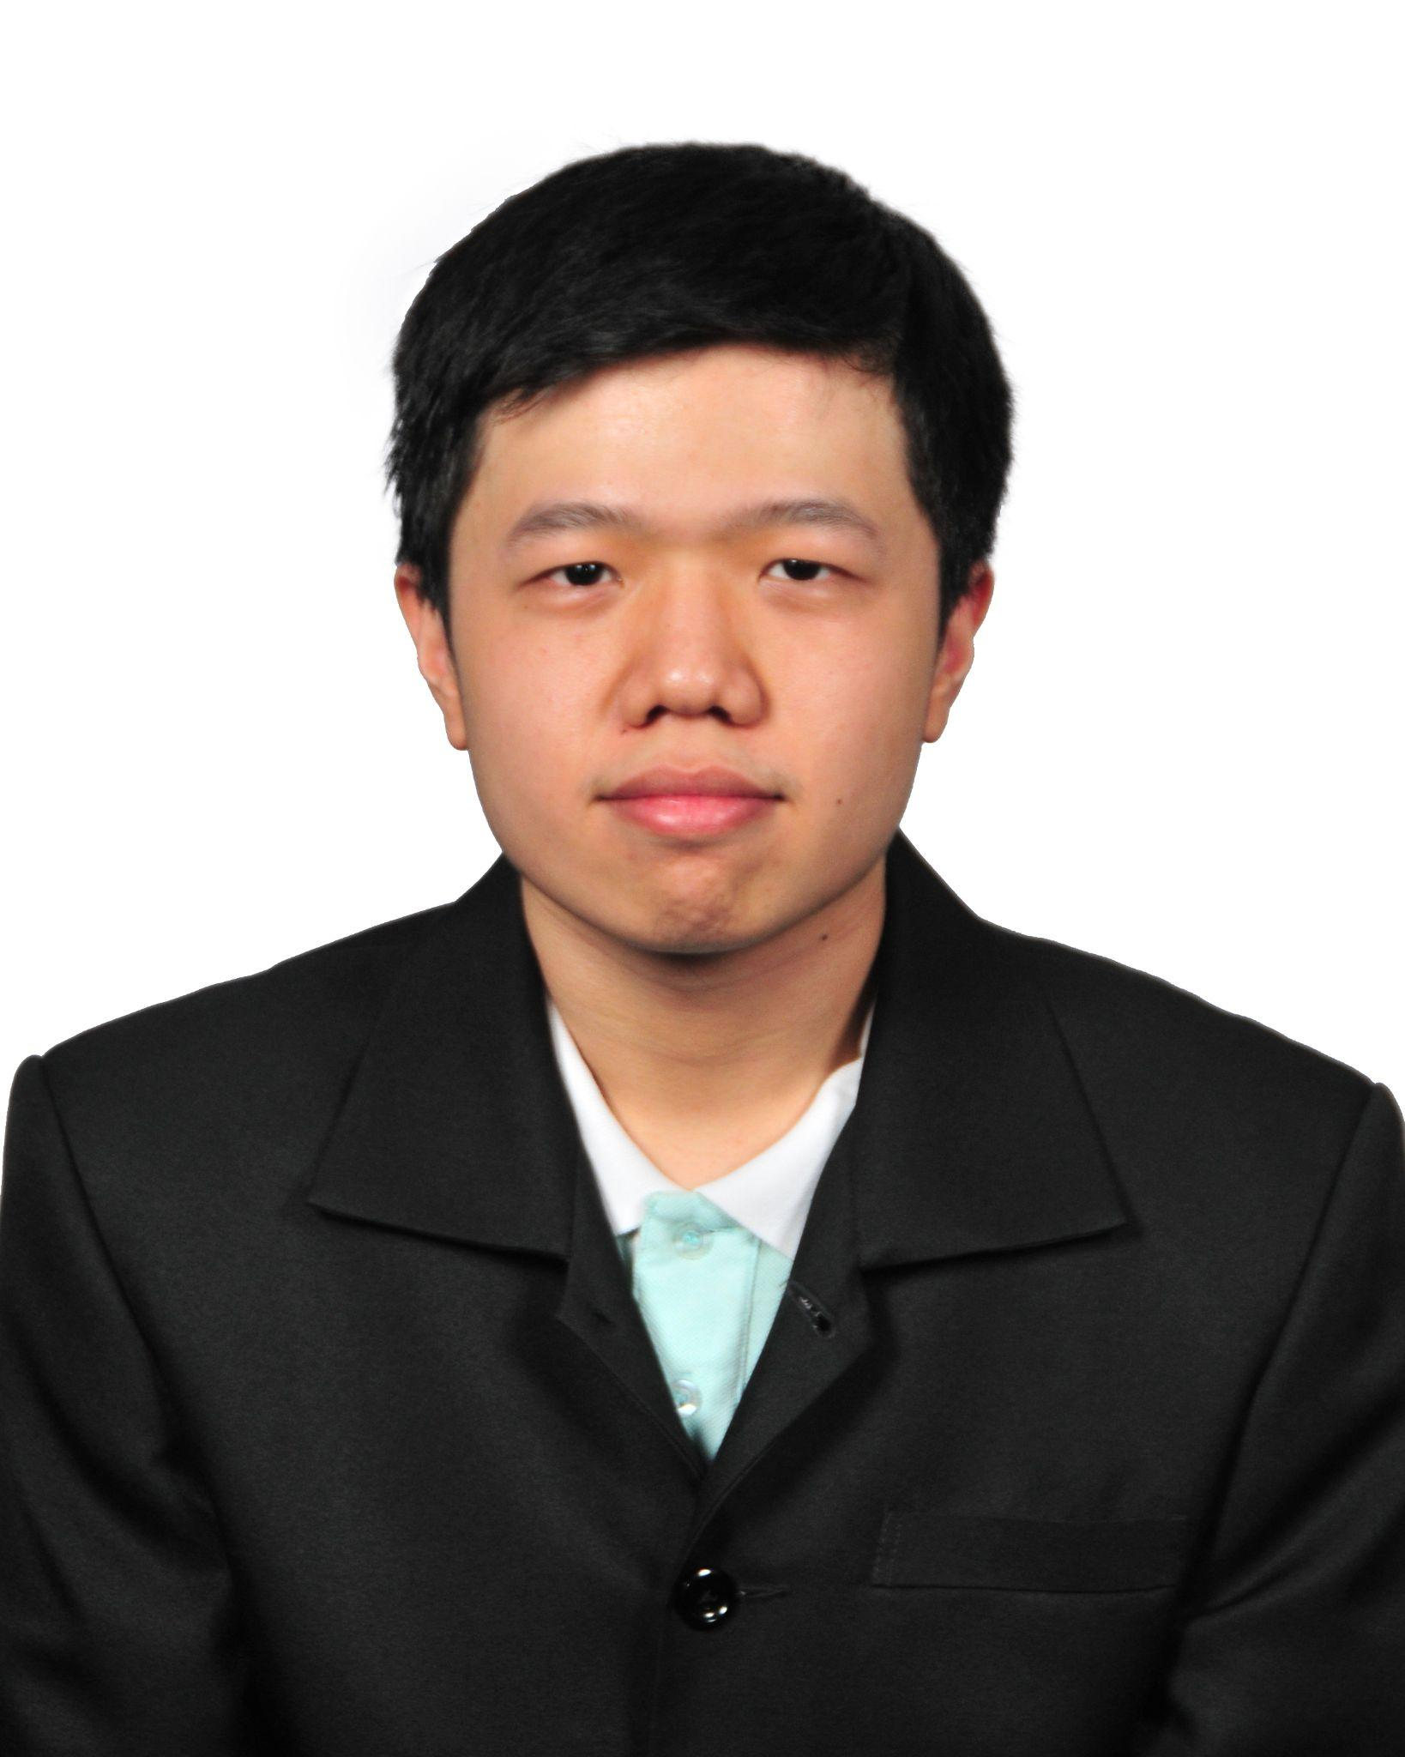
Our Company
Management Team
Chan Siang Sheng
Co-founder and
CAO of Edu.AI
Tang Wen Shuen
Co-founder and President of Edu.AI
Suen Kee Xian
Co-founder and
CIO of Edu.AI
Notes:
kx

Slide 5




Operational Plan
Suntech@Penang Cybercity
Customer Services Executive
Development & Technical Executive
Website Hosting
Notes:
a

Slide 6



Business Model
COVID-19 & Elearning
Business-to-Consumer
(B2C)
Education Organization
Notes:
a

Slide 7
Marketplace Analysis
The emergence of AI-enabled e-learning solutions which helps in the development of a smarter e-learning system.
The closure of public and private schools due to the need for social distancing.
The huge advancement in various technological fields such as Cloud Computer and Virtual Reality.
Notes:
a

Slide 8



Problems
Online Class Attendance Taking Inaccuracy
Knowledge Discrepancy
Unable to capture the students’ behaviour
Notes:
ws

Slide 9

Products and Services
Eddie
The AI online learning classroom assistant
Notes:
ws

Slide 10
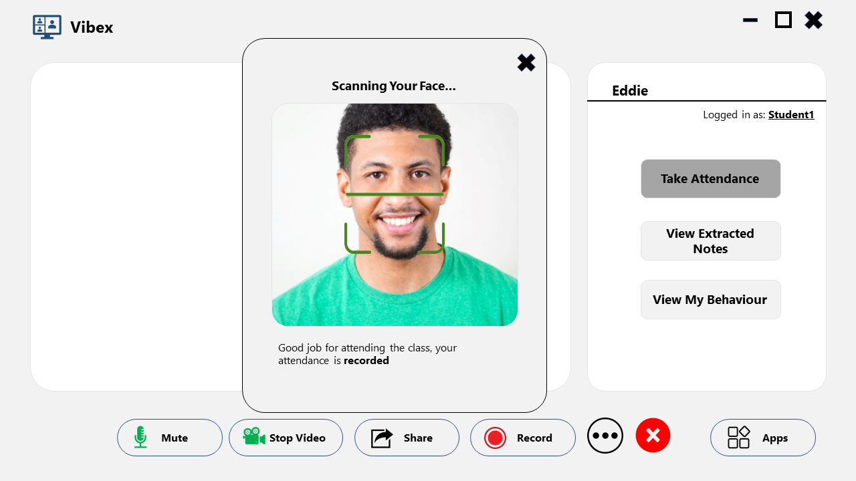
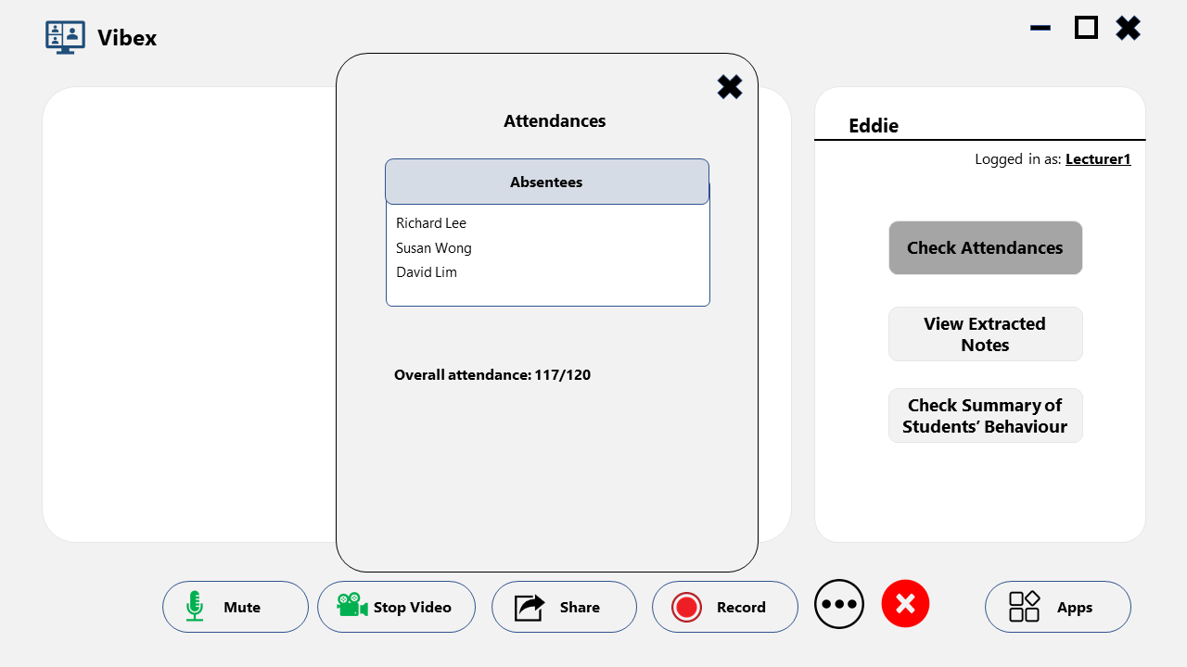
Eddie’s Features
Online Attendance Tracking System
Notes:
ws

Slide 11
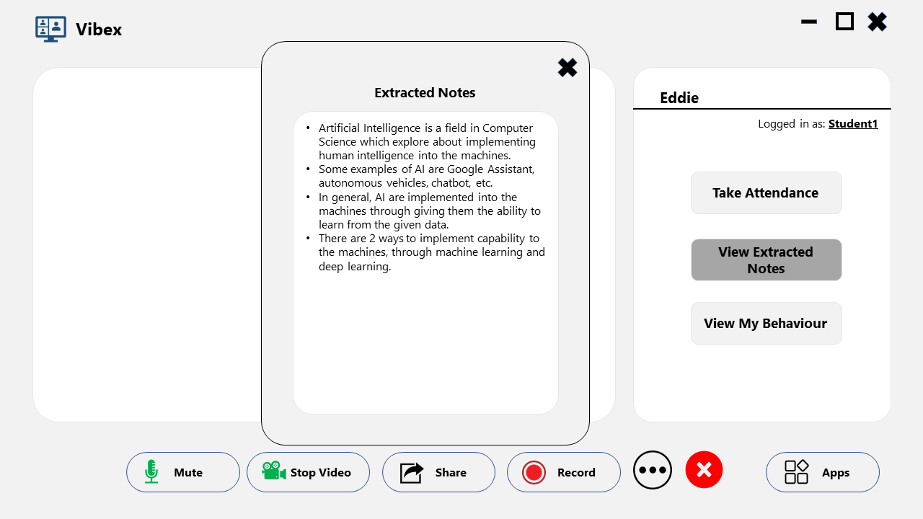
Eddie’s Features
Lecture Keyword Extraction System
Notes:
ws

Slide 12
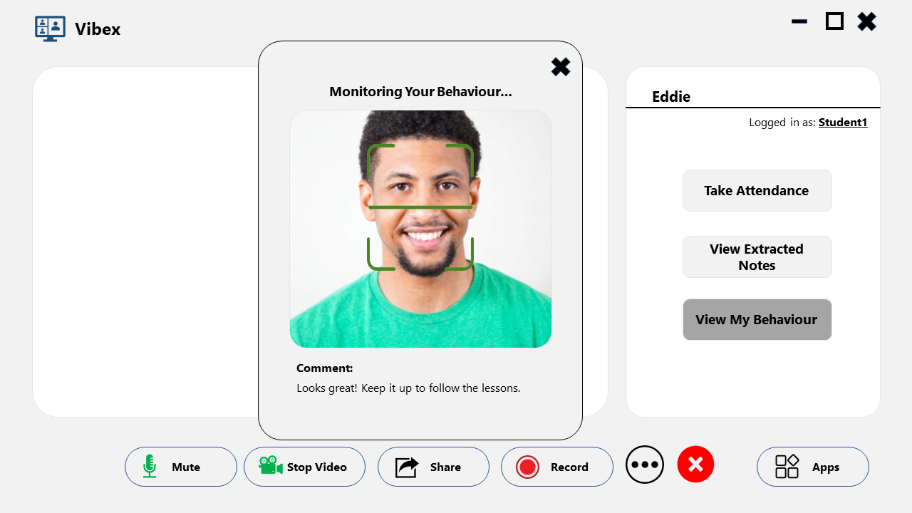
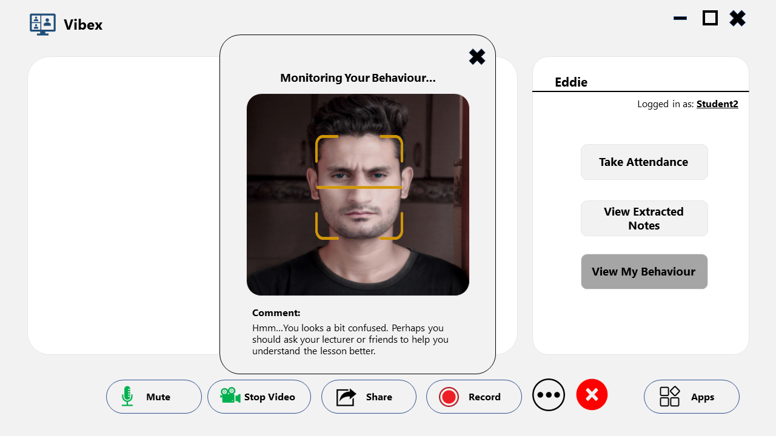
Eddie’s Features
Student Behaviour Tracking System
Notes:
ws

Slide 13
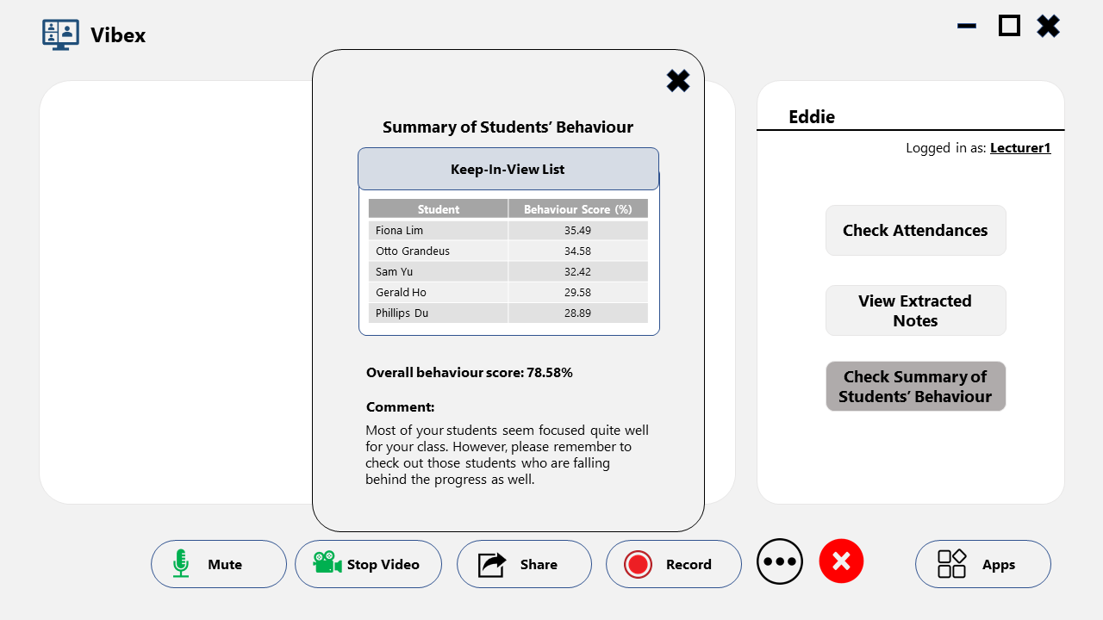
Eddie’s Features
Student Behaviour Tracking System (Continue)
Notes:
ws

Slide 14
Competitors Analysis
Features | Provide Courses/ Lessons | Lesson Notes Extraction | Student Behaviour Tracking | Attendance Tracking | Pricing | Other Remarkable Features
Eddie | No | Intelligently by AI | Intelligently by AI | Intelligently by AI | Up to RM200/month | Flexibility in embedding into other platforms
Google Classroom | Yes | Manually by users | Manually by lecturers | Manually by lecturers | Free/Paid plans for eligible institutions | Integration with Google Workspace
Udemy | Yes | Manually by users | Not applicable | Not applicable | Up to around RM84/month (for IT courses) | Q&A section
Coursera | Yes | Manually by users | Not applicable | Not applicable | Up to around RM331/month | Financial aid
Products
Notes:
ws

Slide 15



Profit Model
Fund new product
Sell services & provide maintenance
Develop & release product
Notes:
kx

Slide 16



Cost Model
Research & Development
Product Maintenance
Salary
RM 24,000
RM 30,000
RM 15,000
Notes:
kx

Slide 17
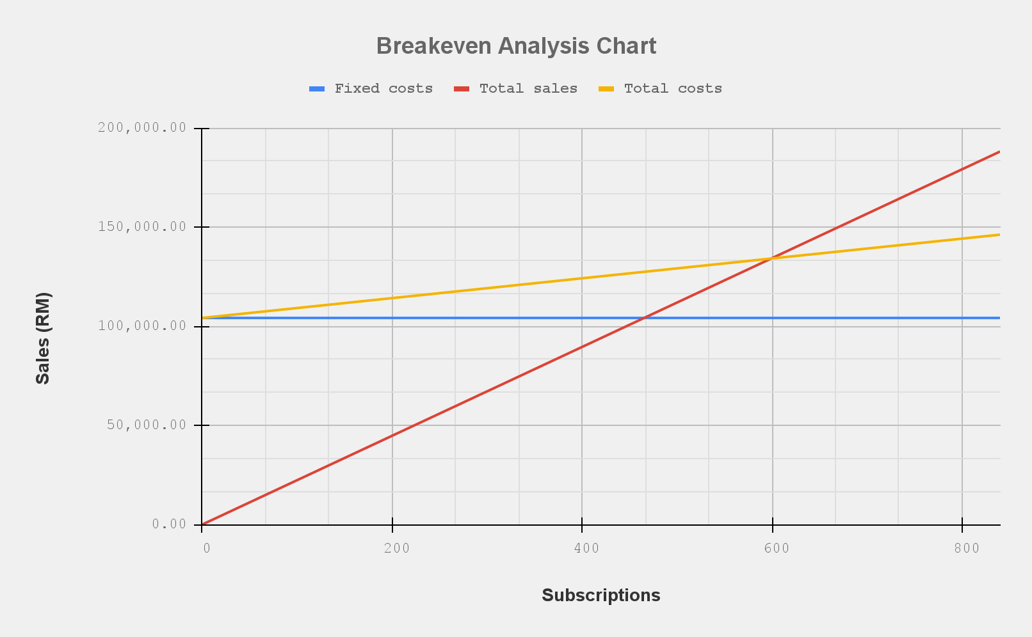
Break Even Analysis
Notes:
kx

Slide 18


Our Competitive Edge
AI Technology
Price
Notes:
a

Slide 19



Future Plan
New product
Partnership
Digital Marketing
Notes:
a

Slide 20
Thank You
Notes:
a

Slide 21



Solutions
Online Attendance
Tracking System
Lecture Keyword Extraction System
Student Behaviour Tracking System

